Slide 1
Hello World
Computer Science Senior Design Project Created By Matthew Tucker Advised by Professor Gowtham Atluri

Slide 2

Project Description
A game designed to teach basic programming concepts
Targeted toward younger students who have never programmed before
Players use basic programming concepts taught throughout game to manipulate objects in the world
First person point of view
3D
Created in Unity Game Engine
C# Scripts

Slide 3
Programming Concepts
Focuses on the ideas of programming rather than the specific syntax
Variables
Conditional Statements
Functions
Loops

Slide 4
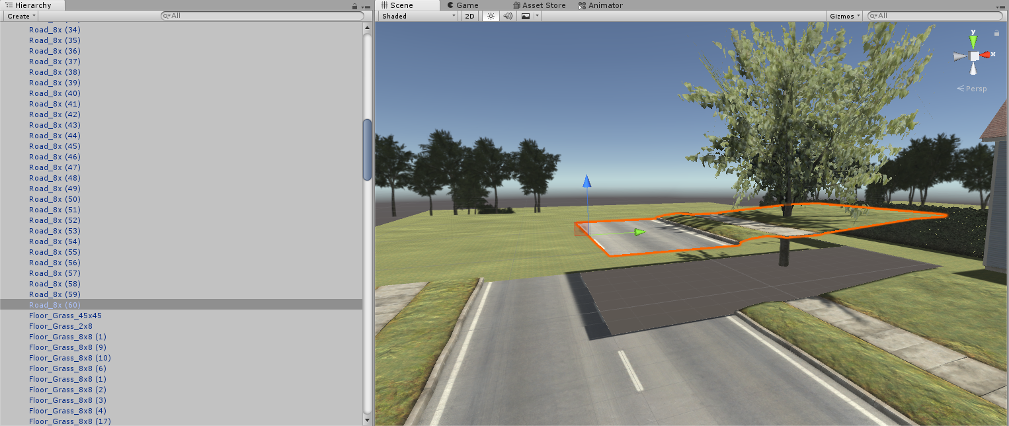
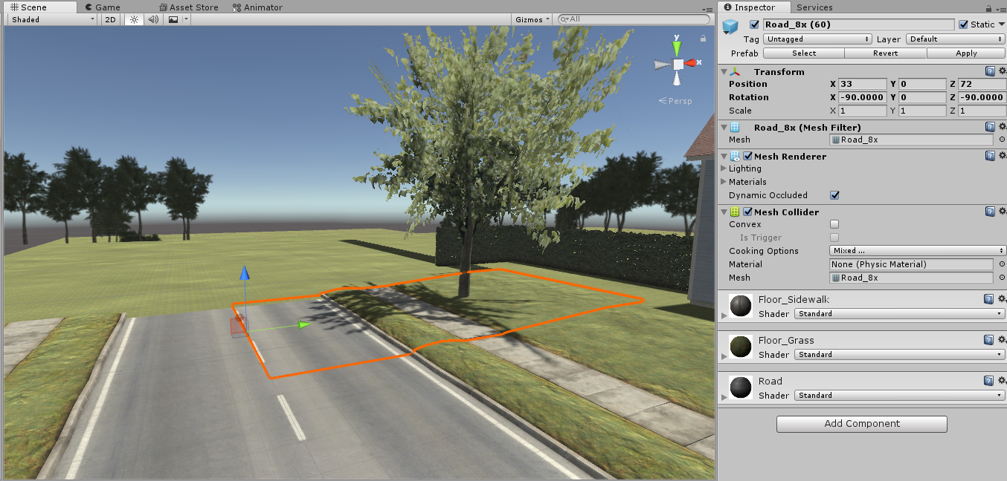
Building the world In Unity
Each object in the hierarchy was added and placed somewhere specific in the environment
Objects placed using editor and Transform component
Eye-opening experience building an environment from scratch

Slide 5
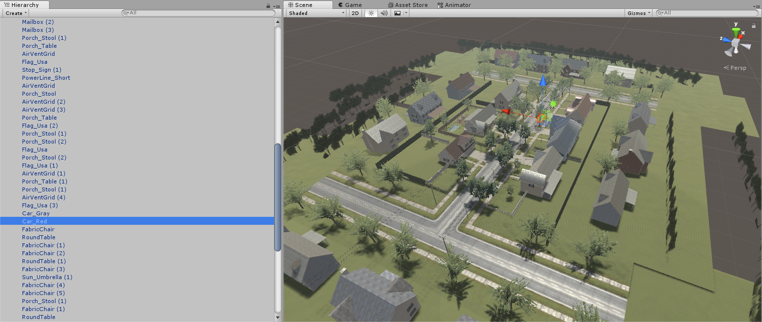
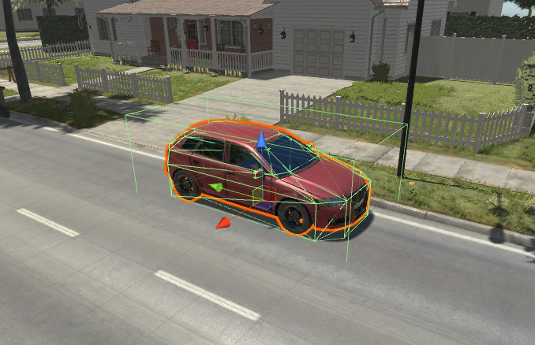
World Overview
Zoomed out perspective of world (players would never see this)
Individual objects can have components attached to them to make them behave appropriately
Attach C# scripts

Slide 6
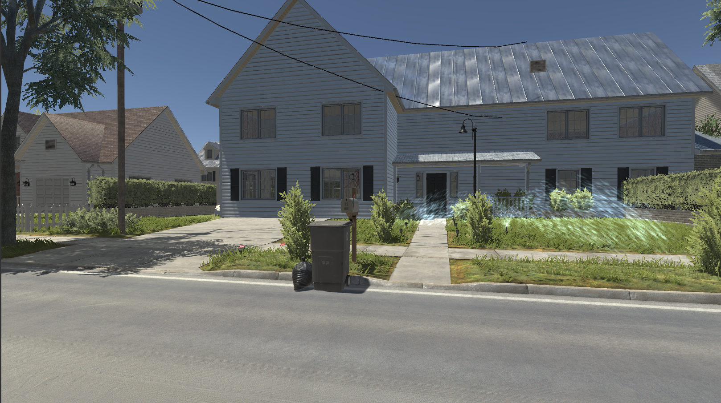
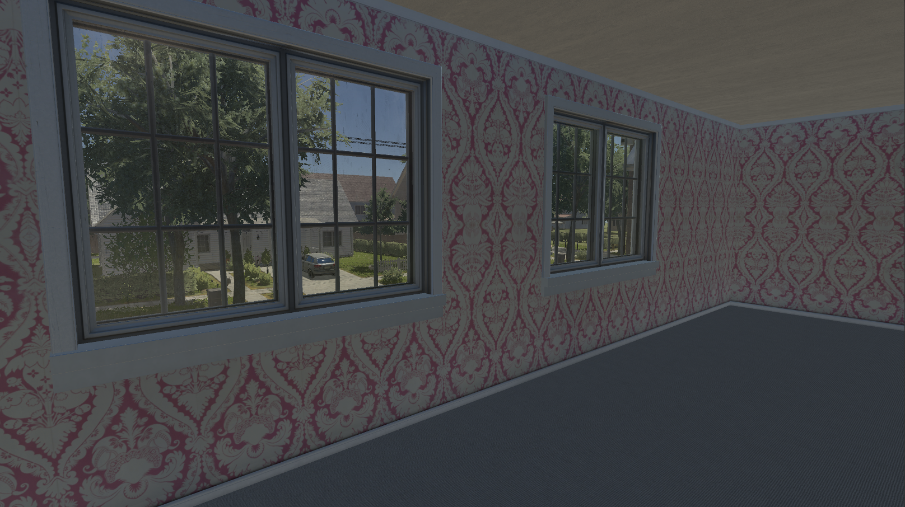
First Person Perspective
Examples of player perspective
WASD and mouse movement

Slide 7
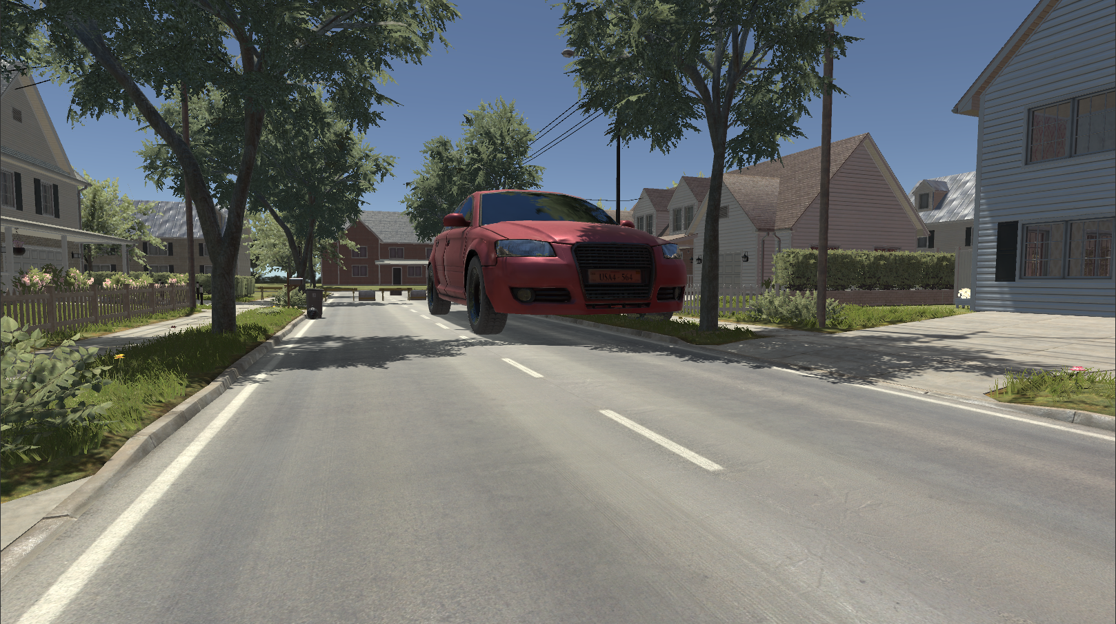
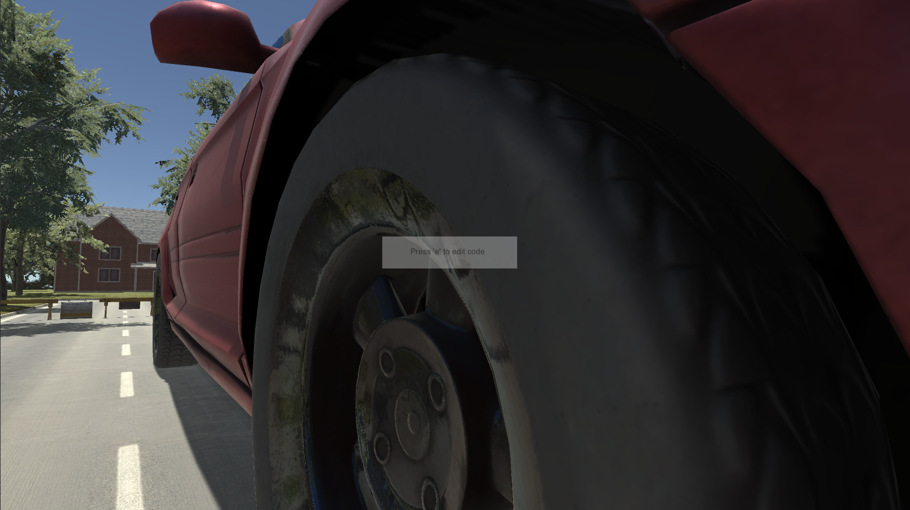
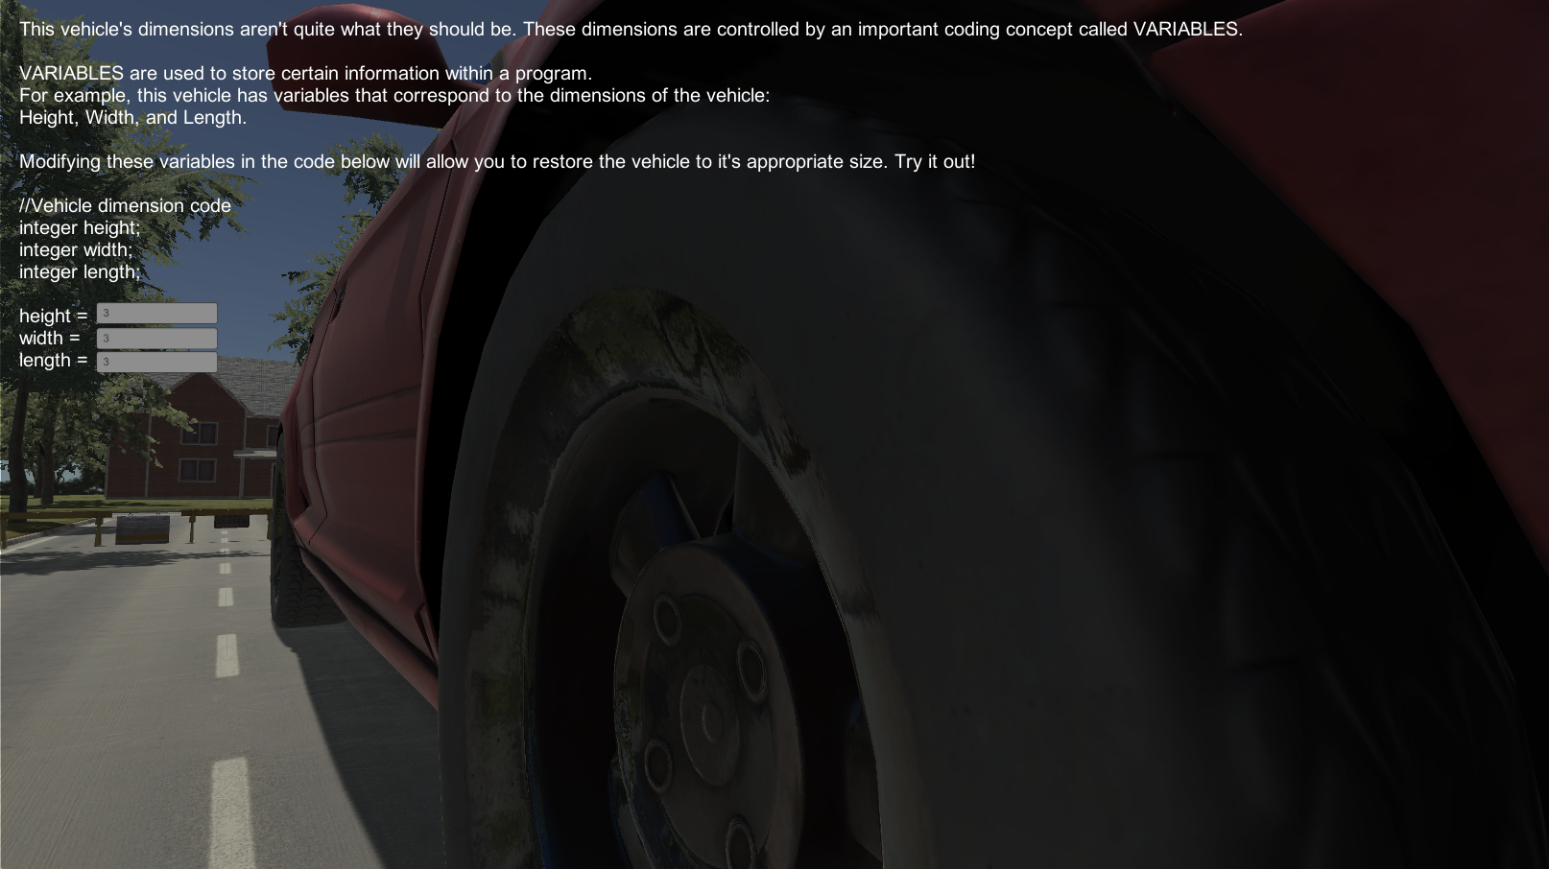
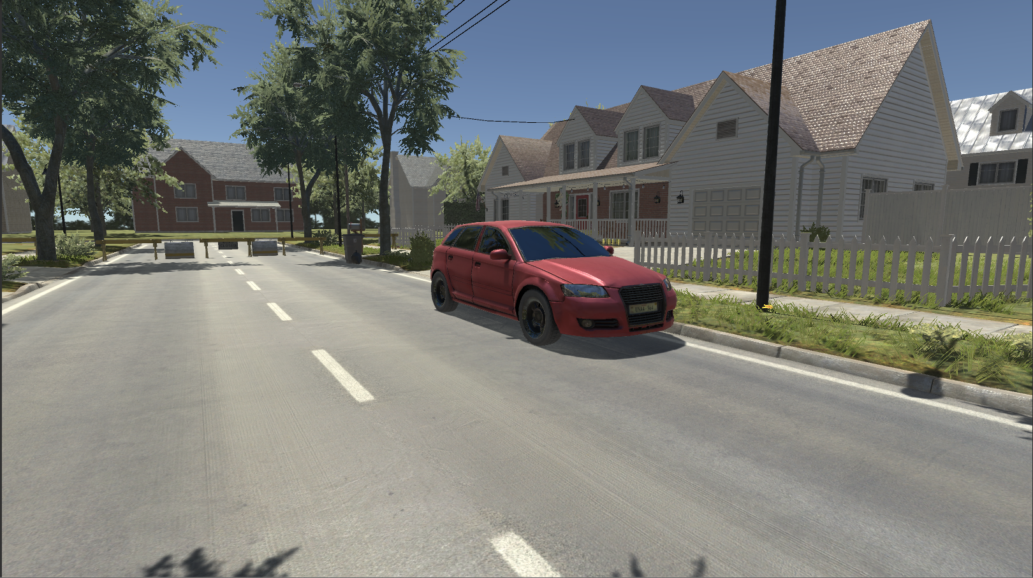
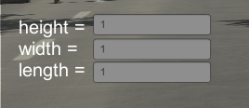
Variable Example

Slide 8
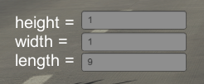
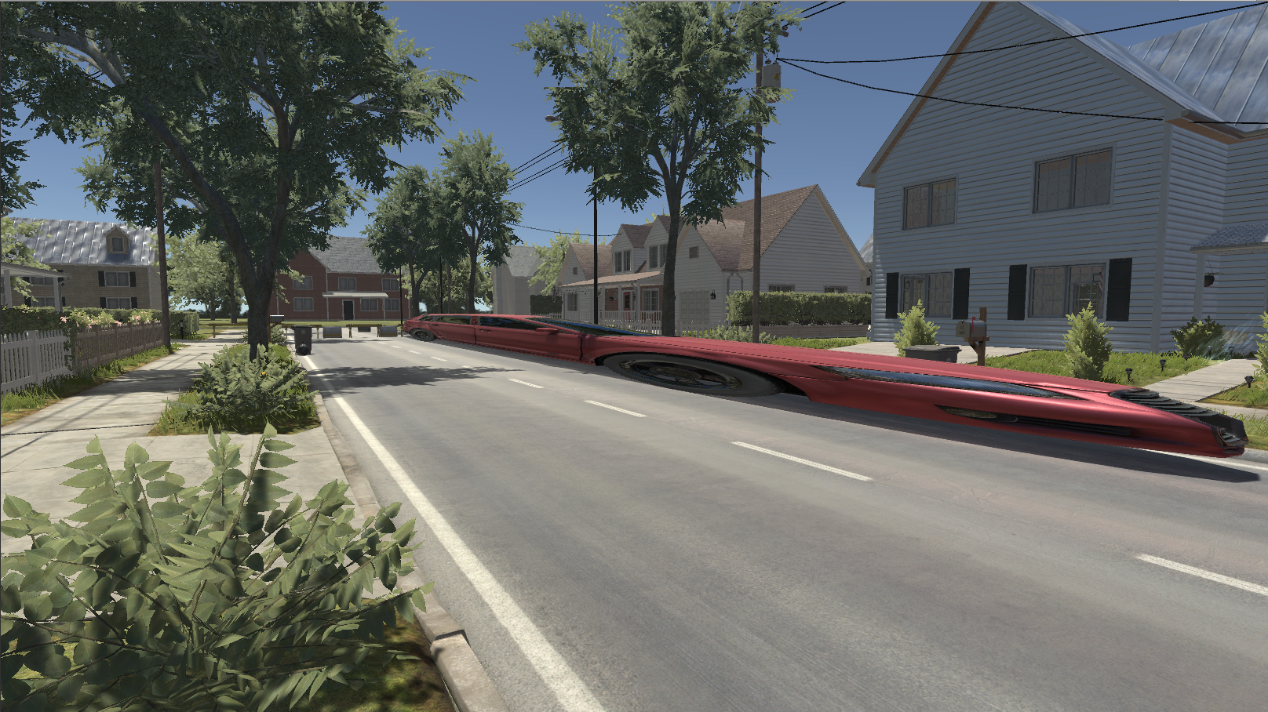
Experimentation
Give players freedom to experiment
See how their actions affect the objects in the environment
More fun

Slide 9
Goals
Players manipulate other objects in the world that teach them certain coding concepts
Players experiment with these objects and see how their changes in the ‘code’ manipulate them
Have a better understanding of coding concepts when formally taught
Have some fun exploring the objects and the environment

